Slide 1
Wrapper Class
Lecture 10 (cont.)

Slide 2
Wrapper class
Primitive types and reference types behave differently. It is sometimes useful to treat primitive values as objects. For this reasons, Java includes wrapper classes for each of the primitive types. The wrapper class is used to convert a primitive type like int to an object.
Boolean, Byte, Short, Character, Integer, Long, Float and Double are immutable classes whose instances each hold a single primitive value.

Slide 3
Wrapper class
Wrappers are classes that wrap up primitive values in classes that offer utility methods to manipulate the values.
The methods are all static so you can use them without creating an instance of the matching wrapper class.
They are also final, once a wrapper has a value assigned to it, that value cannot be changed.

Slide 4
Wrapper class
All wrapper classes except Character provide two constructors: a primitive of the type being constructed, and String representation of the type being constructed. Eg.:
    Integer a1 = new Integer(64);
    Integer a2 = new Integer(“64”);
  or
    Float b1 = new Float(1.23f);
    Float b1 = new Float(“1.23f”);
    Character c1 = new Character(‘c’);

Slide 5
Wrapper class
The valueOf method is a static method that gives the programmer another approach to creating wrapper objects. Eg.:
    Double d = new Double.valueOf( “6.54”);
To convert the value of a wrapped numeric to a primitive, use one of the many xxxValue() methods: byteValue(), doubleValue(), floatValue(), intValue(), longValue() and shortValue() . Eg.:
  Integer c = new Integer(64); // make a new wrapper object
  byte b = c.byteValue(); // convert c’s value to a byte
  double d = c.doubleValue(); // convert c’s value to a double

Slide 6
Wrapper class
One of the most useful type of wrapper method is the parseXX methods : parseInt, parseLong, parseShort, parseCharacter, parseBoolean that convert a String object from different bases to primitive type. The different between parseXXX() and valueOf() is that parseXXX() returns the primitive value, while valueOf() return a newly created wrapped object of the type that invoked the method as shown below.
  double d2 = Double.parseDouble(“3.14”);
  // convert a String to a primitive
  System.out.println(“d2 = “ + d2); // result is d2 : 3.14
  Double d3 = Double.valueOf(“3.14”); // create a Double object
  System.out.println(d3 instanceof Double); // result is “true”

Slide 7
Wrapper class
The toString() method returns a String with the value of the primitive wrapped in the object.
  Double d4 = Double.valueOf(“3.14”);
  // create a Double object
  System.out.println(“d4 =” + d4.toString());
  // result is d4 = 3.14

Slide 8
Auto boxing and unboxing
Java 5.0 introduced autoboxing of primitive types into their wrapper object, and automatic unboxing of the wrapper objects into their primitive value—the implicit conversion between the wrapper objects and primitive values.
With Autoboxing | Without Autoboxing
int i; // i is a … Integer j; // j is a … i = 1; j = 2; i = j; j = i; | int i; Integer j; i = 1; j = new Integer(2); i = j.intValue(); j = new Integer(i);

Slide 9
Auto boxing and unboxing
Autoboxing provides automatic conversions between primitive values and corresponding wrapped objects.
  Integer y = new Integer(97); // make it
  y++; // unwrap it, increment it, rewrapped it
  System.out.println(“y =” + y); // print it y = 98
Without autoboxing we need to unwrap it, use and then rewrapped it
  Integer y = new Integer(567); // make it
  int x = y.intValue(); // unwrap it,
  x++; // use it
  y = new Integer(x); // rewrapped it
  System.out.println(“y =” + y); // print it y = 98

Slide 10
Lab 4
Exercise on Wrapper class
  Do Exercise 2, Question 7 on page 90

Slide 11
Answer Question 7 (page 90)
public class TestWrapper {
public static void main(String[] arg) {
int year = 1957; // a local variable with primitive data type
Integer obj1; // an object
obj1 = year;
System.out.println("Object 1 - obj1: " + obj1);
Integer obj2 = new Integer(1956);
int num2;
num2 = obj2; // unboxing
System.out.println("Number, num2: " + num2);
System.out.println("Object 2 - obj2: " + obj2);
}
}

Slide 12
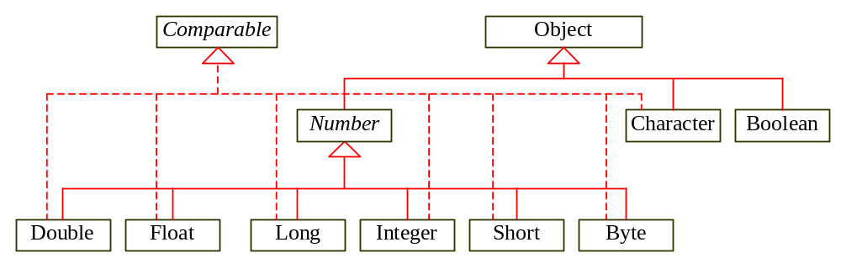
Wrapper Classes
Boolean
Character
Short
Byte
Integer
Long
Float
Double
NOTE: (1) The wrapper classes do not have no-arg constructors. (2) The instances of all wrapper classes are immutable, i.e., their internal values cannot be changed once the objects are created.

Slide 13
The toString, equals, and hashCode Methods
Each wrapper class overrides the toString, equals, and hashCode methods defined in the Object class.
Since all the numeric wrapper classes and the Character class implement the Comparable interface, the compareTo method is implemented in these classes.

Slide 14
The Number Class
Each numeric wrapper class extends the abstract Number class, which contains the methods doubleValue, floatValue, intValue, longValue, shortValue, and byteValue.
These methods “convert” objects into primitive type values. The methods doubleValue, floatValue, intValue, longValue are abstract. The methods byteValue and shortValue are not abstract, which simply return (byte)intValue() and (short)intValue(), respectively.

Slide 15
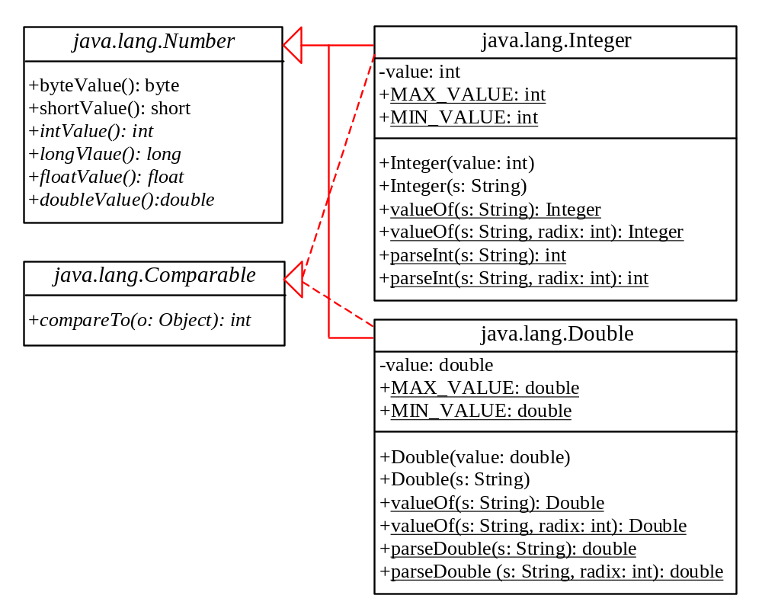
The Integer and Double Classes

Slide 16
The Integer Class and the Double Class
Constructors
Class Constants MAX_VALUE, MIN_VALUE
Conversion Methods

Slide 17
Numeric Wrapper Class Constructors
You can construct a wrapper object either from a primitive data type value or from a string representing the numeric value. The constructors for Integer and Double are:
  public Integer(int value)
  public Integer(String s)
  public Double(double value)
  public Double(String s)

Slide 18
Numeric Wrapper Class Constants
Each numerical wrapper class has the constants MAX_VALUE and MIN_VALUE. MAX_VALUE represents the maximum value of the corresponding primitive data type.
For Byte, Short, Integer, and Long, MIN_VALUE represents the minimum byte, short, int, and long values. For Float and Double, MIN_VALUE represents the minimum positive float and double values.
The following statements display the maximum integer (2,147,483,647), the minimum positive float (1.4E-45), and the maximum double floating-point number (1.79769313486231570e+308d).

Slide 19
Conversion Methods
Each numeric wrapper class implements the abstract methods doubleValue, floatValue, intValue, longValue, and shortValue, which are defined in the Number class.
These methods “convert” objects into primitive type values.

Slide 20
Wrapper Classes for primitive types
Wrapper class: a class that stores a primitive type value in an object and contains methods for converting back and forth
All are defined in in the java.lang package of the Java API (Application Programming Interface - a standard set of Java class libraries).
Each wrapper class includes the following constructors and methods:
  a constructor that takes a primitive type value and converts it into an object
  Double w = new Double (3.14159);
  a constructor that takes a string representation of a primitive type value
  Double w = new Double ( “3.14159” );
  a toString() method that creates a string version of the object’s value
  w.toString() returns the string “3.14159”
  a typeValue method (i.e., intValue , doubleValue ) that returns the primitive type value stored in the wrapper object:
  w.doubleValue() returns the double value 3.14159
  an equals method that compare for equality to wrapper objects of the same class: assuming that x and y are of type Double, then x.equals(y) returns true when they wrap the same value.

